Slide 1

DEFENCE SERVICES ACADEMY
M.Sc (21st Batch) Computer Science
DEPARTMENT OF COMPUTER SCIENCE
Pyin Oo Lwin
Notes:
Good Afternoon! Honorable and invited guests, all of my Lecturers, supervisor and my batch friends.

Slide 2
IMPLEMENTATION OF AN AUTOMATED DYNAMIC WEAPON RANGE VISUALIZATION AND ENGAGAEMENT PLANNING FOR MILITARY TACTICAL SUPPORT SYSTEM USING GEOSPATIAL DATA
Presented by
Captain Aung Nyi Nyi Min
M.Sc (21th Batch)
Supervisor Lt.Col Zar Nay Lin
Notes:
Firstly, May I introduce myself.
I'm Captain Aung Nyi Nyi min, and Master Candidate at Department of Computer Science.
Today I' would like to present my thesis work.
The title of my thesis is “IMPLEMENTATION OF AN AUTOMATED DYNAMIC WEAPON RANGE VISUALIZATION AND ENGAGAEMENT PLANNING FOR MILITARY TACTICAL SUPPORT SYSTEM USING GEOSPATIAL DATA” .
And my supervisor is Lt.Col Zar Nay Lin, and Co-supervisor is Major Zin Min Thu.

Slide 3
Outlines
Abstract
Introduction
Aim of Thesis
Objectives of Thesis
Problem Statement
Background Theories
Conclusion
3
Notes:
OK! First of all, I would like to present outlines of my thesis.
In this seminar, I will present our thesis as these program. And generally divided by 7 state.
First stage is the abstract of our thesis.
Second stage is the Introduction of our thesis.
Third stage is the Aim of our thesis.
Fourth stage is the Objectives of our thesis.
Fifth is the Problem Statement .
Sixth is the Scope of thesis and background theory.
Finally, is the conclusion of our thesis.

Slide 4
Abstarct
The system automates the process of mapping current and target locations, measuring distances, and visualizing weapon ranges based on their power and specifications.
The system integrates various APIs to retrieve real-time geolocation data and converts geographic coordinates to the Military Grid Reference System (MGRS) for accurate positioning.
The system calculates the distance from the current location to the desired target, visualizes the effective firing ranges on interactive maps, and identifies the optimal troops and weapons for engagement based on proximity and ammunition requirements.
Notes:
In this slides, May I present about the abstract of my thesis.

Slide 5
Introduction
In the realm of modern warfare, the precision and efficiency of tactical operations are paramount to mission success.
Traditional methods of planning and executing tactical operations are often time-consuming and prone to human error, necessitating the development of automated systems that can enhance decision-making processes.
The system supports the ability to quickly and accurately determine the positioning of forces, calculate engagement ranges, and optimize resource allocation can significantly impact the outcome of military engagements.
Notes:
Now I would like to present the introduction of system.

Slide 6
Aim of My Thesis
The primary aim of this thesis is to develop an automated system that supports military tactical planning by dynamically visualizing weapon firing ranges and optimizing engagement strategies using real-time geospatial data. This system is designed to improve the efficiency and accuracy of military operations, ultimately contributing to mission success.
Notes:
Now I would like to present the Aim of my thesis

Slide 7
Objectives
To develop a geospatial data processing framework that integrates various sources of geospatial and military data
To design an automated tool for visualizing weapon range dynamics, considering the effects of real-time data inputs
To develop a visualization module based on weapon specifications
To create an engagement planning module that supports military personnel in determining optimal weapon usage strategies
Notes:
And then I would like to present the objectives of our thesis.

Slide 8
Problem Statement
In modern military, effective tactical planning and resource allocation are critical for mission success and minimizing collateral damage.
The current methods of tactical planning are time-consuming, prone to human error, and lack the agility required for real-time decision-making.
This thesis aims to develop an Automated TDSS that integrates real-time geospatial data, advanced algorithms, and intuitive visualizations to enhance tactical planning.
Notes:
And then I would like to present the problem statement of system.

Slide 9
Background Theory
Flutter
Web API
GIS
Military Grid Reference System (MGRS)
Map Caching for Online and Offline Use
LatLng to MGRS Conversion
Tactical Decision Support System (TDSS)
Notes:
In this slide, I would like to present the background thoery of system.

Slide 10
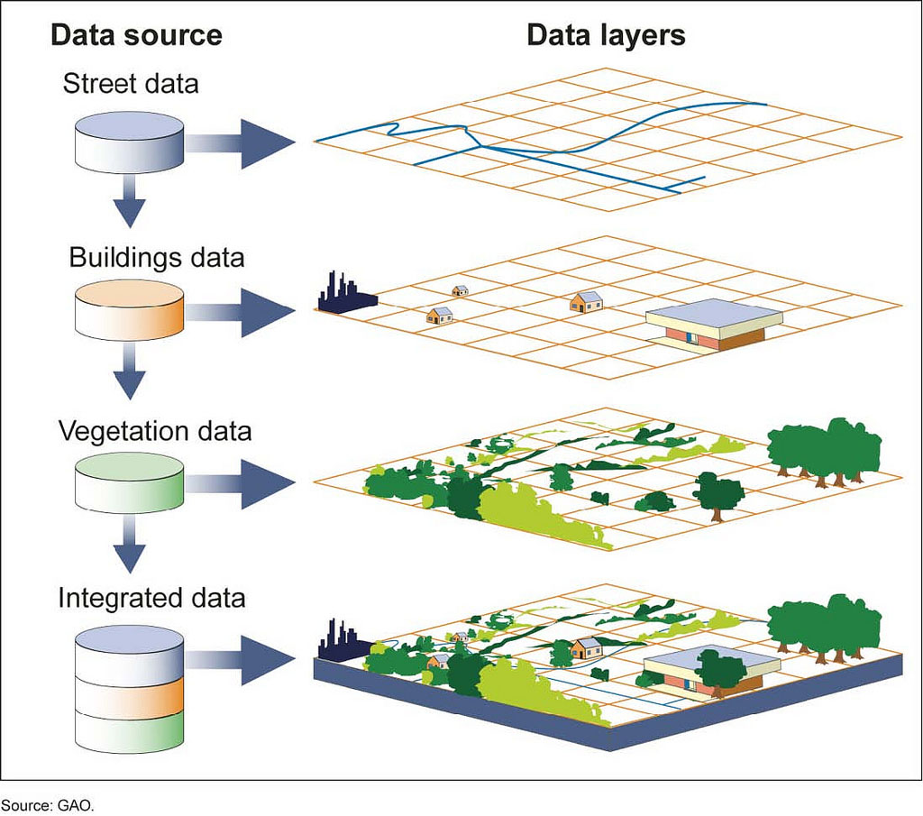
Geospatial Information Systems (GIS)
Geospatial Information Systems (GIS) represent a pivotal technology in the realm of spatial data management and analysis. GIS integrates hardware, software, and data for capturing, managing, analyzing, and displaying all forms of geographically referenced information. This technology has become indispensable across various disciplines, including urban planning, environmental management, logistics, epidemiology, natural resource management, and of course, military operations.

Slide 11
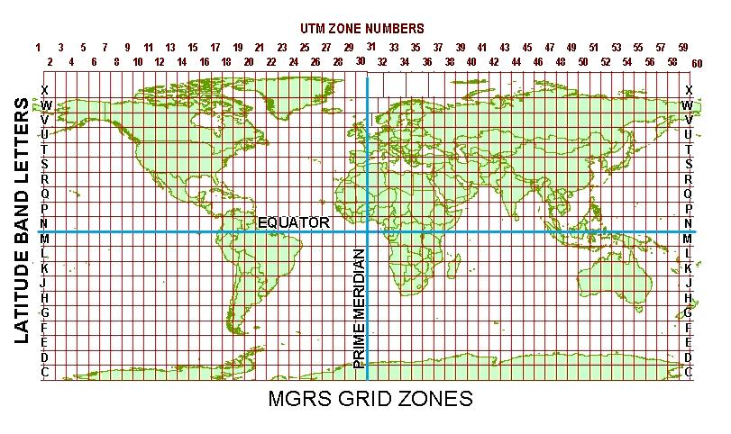
Military Grid Reference System (MGRS)
The Military Grid Reference System (MGRS) is a geographic coordinate system used extensively by military forces worldwide for locating points on the Earth's surface. It is based on the Universal Transverse Mercator (UTM) coordinate system but provides a more concise and standardized method of representing geographic coordinates.

Slide 12
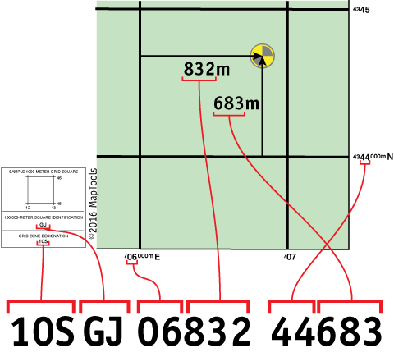
Latitude/Longitude to MGRS Conversion
The conversion from LatLng (latitude, longitude) to MGRS involves several steps, including:
Convert LatLng to UTM (Universal Transverse Mercator) coordinates
Determine the UTM zone
Convert UTM to MGRS

Slide 13
Algorithm Lat/Long to MGRS Conversion
Validate Latitude
Ensure lat is between -80° and 84°.
Zone and Meridian Calculation
Calculate Zone Number: (lon + 180) / 6.
Determine Central Meridian for the zone.
Convert Coordinates
Latitude/Longitude → Radians.
Compute trigonometric values (sin, cos, tan).
UTM Calculations
Easting (x): Adjusted with false easting (+500,000).
Northing (y): Adjusted with false northing (if in Southern Hemisphere).
Grid Square Letters
Determine Zone Letter based on latitude.
Compute 100k Easting (e100k) and Northing (n100k) letters.
Precision Adjustment
Extract 5-digit precision for Easting and Northing.
Construct MGRS String
Combine: ZoneNumber + ZoneLetter + GridLetters + Easting + Northing.
Output: MGRS coordinate string (e.g., 47Q KE 36177 31969).

Slide 14
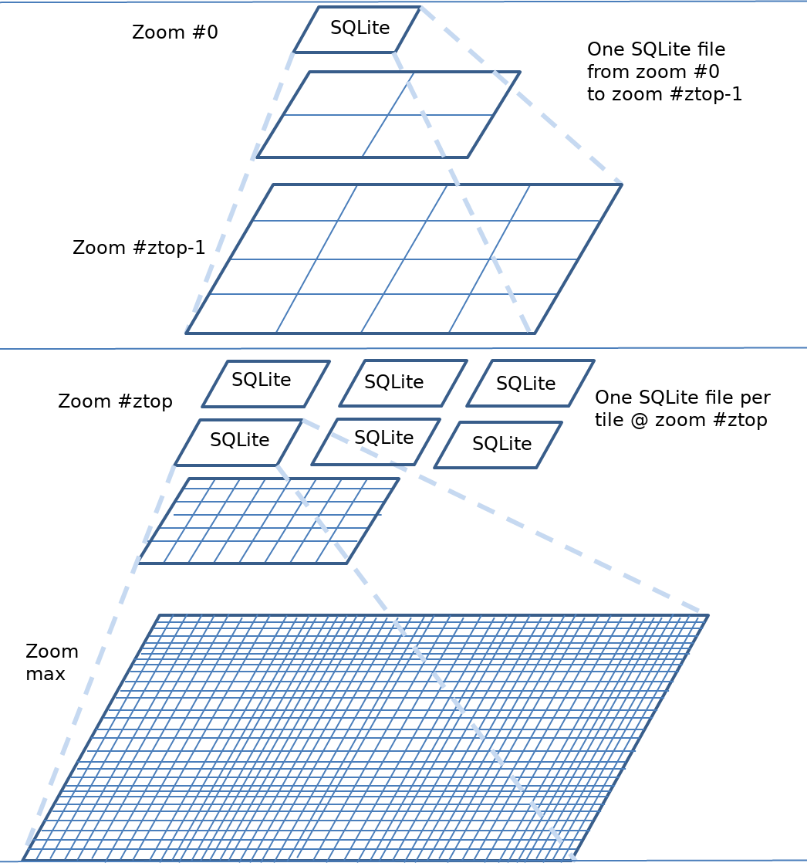
Map Caching for Online and Offline Use
A caching mechanism can be employed to locally store map tiles once they are download, enabling the system to use these cached resources when connectivity is lost.

Slide 15
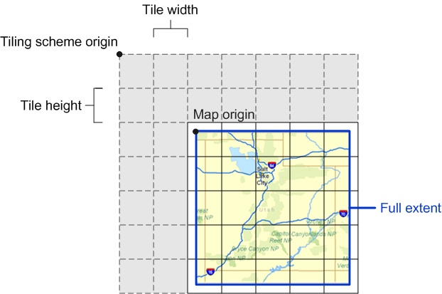
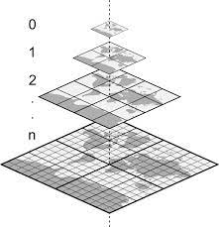
Map Caching for Online and Offline Use Cont’d
Procedure of map tiles cache solution
Tiles Provider Customization (getImage)
Dynamic URL Generation (getTileUrl)
Custom Image Provider (loadImage or _loadsyns)
Handling Online and Offline Mode

Slide 16

Tactical Decision Support System (TDSS)
A Tactical Decision Support System (TDSS) is a specialized software application designed to assist military commanders and decision-makers in making informed decisions during tactical operations. It integrates various data sources, analytical tools, and visualization techniques to provide real-time situational awareness and actionable insights.

Slide 17
Key Components of TDSS
Distance Calculation & Bearing
Route Planning
Weapon Firing Solutions
Spatial Analysis

Slide 18
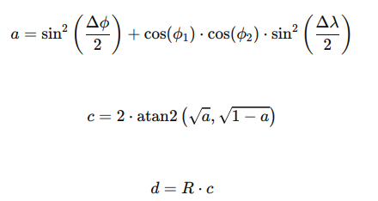
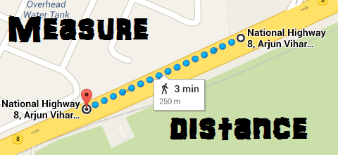
Distance Calculation From One Place To Another
Distance Calculation: Here use Haversine Formula to calculate distance.
Where:
ϕ1​,ϕ2​: Latitudes of the two points
Δϕ, Δλ: Differences in latitude and longitude between the points
R: Radius of the Earth (mean radius = 6,371 km)
d is the distance between the two points along the surface of the sphere.

Slide 19

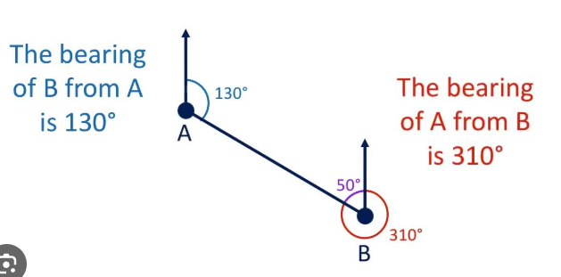
Distance Bearing From One Place To Another
Distance Bearing: The formula for bearing calculation is as follows.
Where:
ϕ1, ϕ2 ​: Latitudes of the two points (in radians).
Δλ: Difference in longitudes (λ2−λ1 ​, in radians).
θ: The calculated bearing in radians.
Finally, the result is converted to degrees and normalized to a range of 0∘ to 360∘ using:

Slide 20
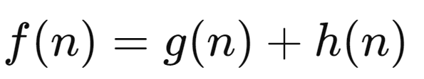
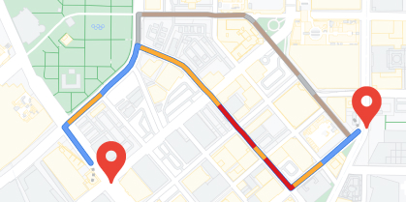
Route Planning For One Place To Another
Route Planning : Here use A Algorithm (A-star) to calculate Route Planning.
Where:
f(n): Estimated total cost of path through node n
g(n): Cost to reach node n
h(n): Estimated cost from n to the goal based on heuristic

Slide 21
General Equations and Algorithms Used in TDSS
Bullet Flight Time Calculation: The bullet flight time decreases linearly with the increase in range within specific intervals. The formula for bullet flight time can be defined as:
Bullet Flight Time = Initial Time - (Range - Min Range/ Max Range - MinRange) × (Initial Time - Final Time)
Long Distance Calculation: The long-distance value decreases linearly with the range within defined intervals. The formula is:
Long Distance = Initial Distance - (Range - Min Range /Max Range - Min Range) × (Initial Distance - Final Distance)
Gun Power Calculation: Gun power is assigned based on specific range intervals and typically increases as the range increases.

Slide 22
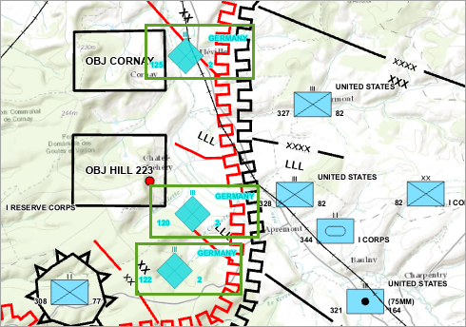
Spatial Analysis for Positioning Data on Map
Spatial Analysis :
Overlay Operations: Used to analyze spatial relationships between different layers or datasets on a map. Operations include intersection, union, difference, and buffering to determine areas of overlap, containment, or proximity between spatial features.

Slide 23


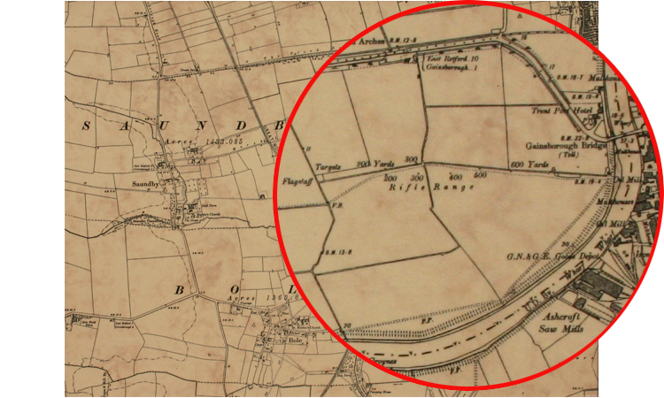


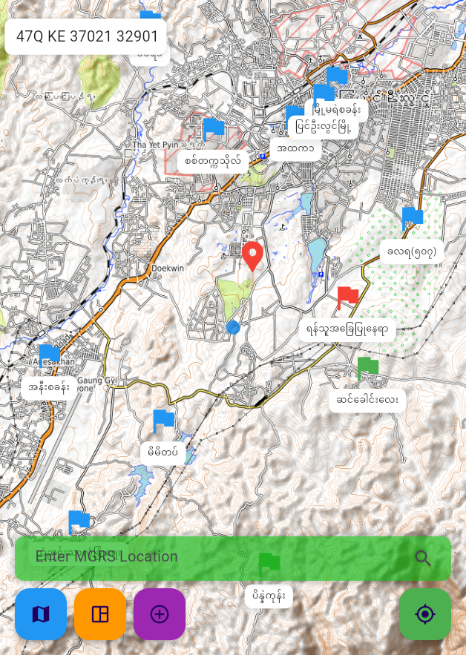

Proposed System Architecture
Weapon Range Specification
Real-Time Location Data
Geospatial Data
Dynamic Visualization Engine(Real-Time Map On Android or IOS)
Engagement Planning & TDSS Interface
Real-time Data Processing
Feedbacks & Adjustment Loop

Slide 24
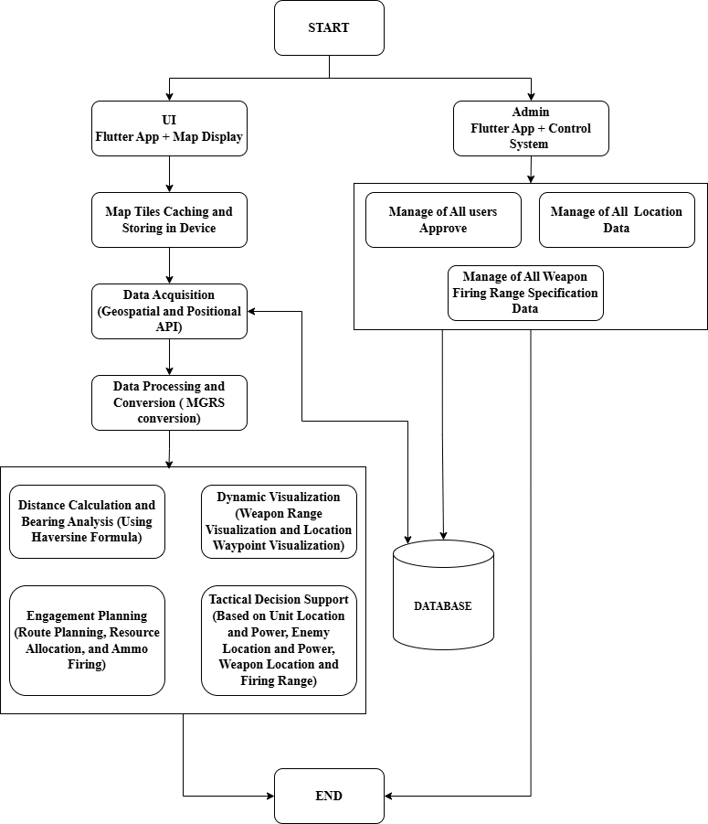
Overall Design of the System

Slide 25
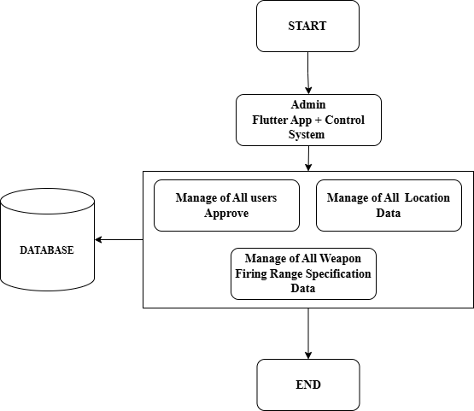
Detail Design for Admin

Slide 26
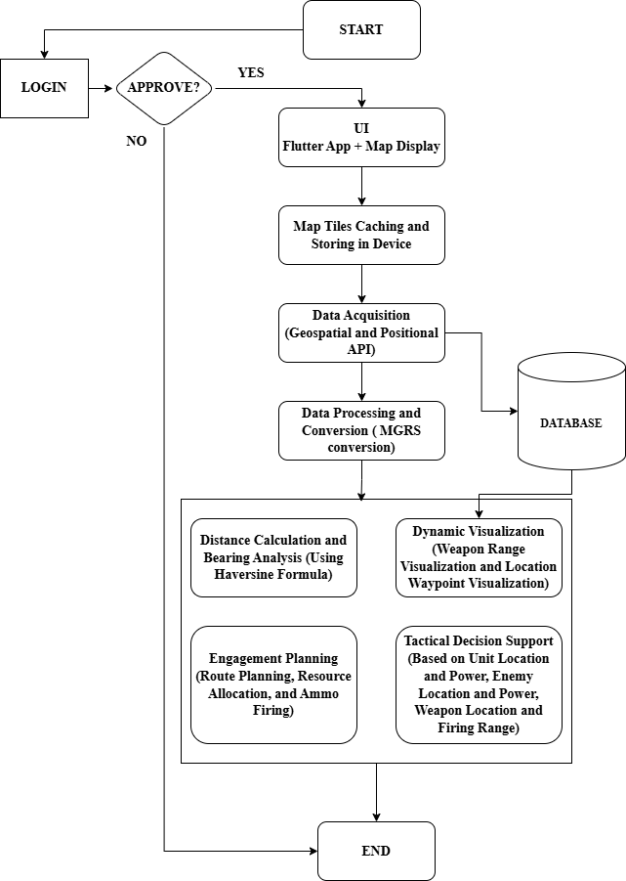
Detail Design for UI

Slide 27
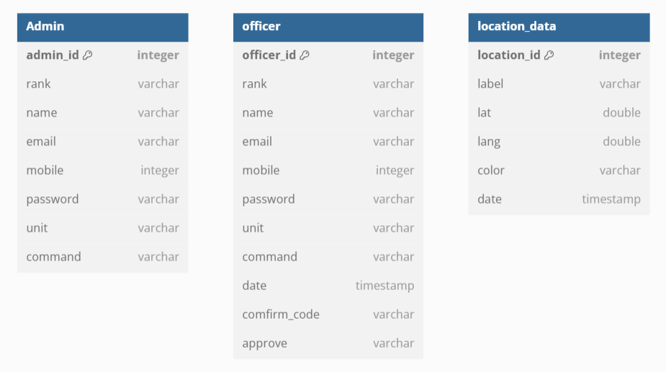
Proposed System Design for Database

Slide 28
Conclusion
This system supports an Automated Military Tactical Support System, designed to leverage advancements in Geospatial Information Systems (GIS) and algorithmic optimization to provide dynamic visualizations of weapon firing ranges and comprehensive engagement planning.
It also supports to automate the process of retrieving location data, measuring distances, visualizing weapon ranges, and calculating optimal engagement strategies, thereby providing military personnel with a robust tool for more precise and effective decision-making.

Slide 29
Benefits of the System
The system provides precise distance and bearing calculations, enabling commanders to make informed decisions in real-time operational scenarios.
By identifying suitable weapons based on range, firepower, and target location, the system ensures optimal weapon utilization, minimizing wastage of resources and maximizing effectiveness.
The system offers real-time, map-based visualization of weapon ranges, allowing users to analyze coverage areas and plan engagements effectively.
The ability to input MGRS coordinates and visualize multiple weapon ranges helps streamline resource allocation and deployment, enhancing operational efficiency.
By integrating geospatial data, the system provides a comprehensive overview of the battlefield, enabling users to anticipate threats and plan strategies more effectively.

Slide 30
Limitation of the System
Dependency on Geospatial Data Accuracy: The system's performance heavily relies on the accuracy and resolution of the geospatial data. Errors or outdated maps could lead to inaccurate calculations and suboptimal tactical decisions.
Limited Offline Functionality: While the system supports offline map tiles, certain features, such as live data updates and online map integration, are restricted when an internet connection is unavailable.
Scalability Challenges: The system may face challenges in managing a high volume of data or accommodating large-scale operations involving multiple units and weapon types.
Complex Environmental Factors: The system does not account for dynamic environmental factors such as terrain elevation, weather conditions, or obstacles, which may impact the accuracy of weapon range and target engagement.
Limited Weapon Database: The system depends on a predefined database of weapon specifications. It may not accommodate all available weapons or accurately model newly developed weapon systems without manual updates.

Slide 31
References
[1] Madhuri, R., & Radhakrishnan, M. (2020). Flutter: A Modern Framework for Cross-Platform Mobile Application Development. International Journal of Computer Applications, 175(9), 10-14.
[2] https://education.nationalgeographic.org/resource/geographic -information - system-gis/.
[3] El-Gohary, M., & El-Rabbany, A. (2011). Applications of Geographic Information Systems (GIS) in Military Operations. In Proceedings of the 2011 International Conference on Military Communications and Information Systems (ICMCIS) (pp. 1-6). IEEE. https://doi.org/10.1109/ ICMCIS.2011.5970145.
[4] U.S. Department of Defense (2019). Geospatial Intelligence: A Guide for Military Applications. Department of Defense, Washington, D.C.
[5] Karney, C. F. F. (2011). Transverse Mercator with an accuracy of a few nanometers. Journal of Geodesy, 85(8), 475–485. https://doi.org/10.1007/ s00190-011-0445-3.

Slide 32
References Cont’d
[6] Defense Mapping Agency, Technical Manual 8358.1: Datums, Ellipsoids, Grids, and Grid Reference Systems, 1989.
[7] Hale, M., & Davis, R. (2020). The Role of Tactical Decision Support Systems in Modern Warfare. Defense Technology Journal, 14(3), 213-225. https://doi.org/10.1016/j.deftech.2020.01.012
[8] NATO Standardization Office. (2017). Glossary of Terms and Definitions (AAP-06). Retrieved from https://www.nato.int/docu/standard.htm
[9] Huang, B., & Liu, N. (2018). Advances in Mobile Map Caching for Seamless Navigation. Journal of Location-Based Services, 12(2), 89–102. https://doi.org/10.1080/17489725.2018.1435534
[10] Epstein, J. M. (1985). The Calculus of Conventional War: Dynamic Analysis Without Lanchester Theory. Brookings Institution.
[11] Tolk, A., Diallo, S. Y., & Wang, W. (2013). Modeling and Simulation Support for System of Systems Engineering Applications. Wiley. https://doi.org/10.1002/ 9781118555922

Slide 33
Comment & Suggestions?

Slide 34
Thank You

